Slide 1
Drill with TensorFlow 2.x
Week 10
Ph.D. Junetae, Kim
Assistant professor

Slide 2
Contents
Multiclassification
Iris classification
Understanding overfitting
Introduction to overfitting
Split the data into a training and validation set
K-fold cross validation

Slide 3
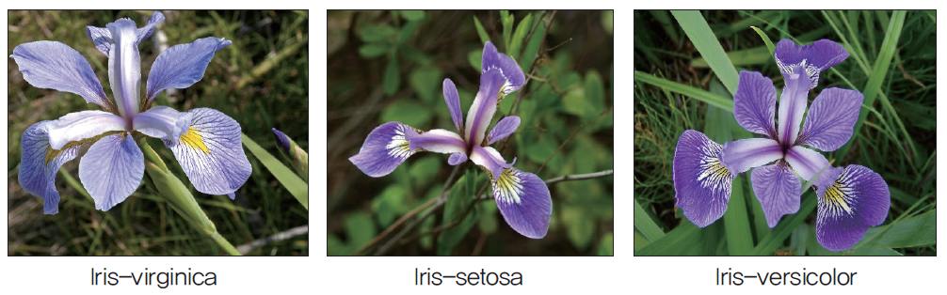
Multiclassification
Description of iris classification
Iris is divided into several species according to the shape and length of the petals.
Given similar flowers, can deep learning distinguish their species?

Slide 4
Multiclassification
Description of iris dataset
dataset/iris.csv
ID | feature1 | feature2 | feature3 | feature4 | species
1 | 5.1 | 3.5 | 4.0 | 0.2 | Iris-setosa
2 | 4.9 | 3.0 | 1.4 | 0.2 | Iris-setosa
3 | 4.7 | 3.2 | 1.3 | 0.3 | Iris-setosa
… | … | … | … | … | …
150 | 5.9 | 3.0 | 5.1 | 1.8 | Iris-virginica

Slide 5
Multiclassification
Description of iris dataset
# of obs. : 150
# of features: 4
Feature1: sepal length (cm)
Feature2: sepal width (cm)
Feature3: petal length (cm)
Feature4: petal width (cm)
Class: Iris-setosa, Iris-versicolor, Iris-virginica

Slide 6
Multiclassification
Description of multiclassification problem
More than 2 classes to predict
In other words, it is not a problem to solve with true (1) and false (0), but to predict which of several is the answer.
Multi-classification problems take a different approach than binary classification problems, where models choose one or the other.

Slide 7
Multiclassification
Descriptive analysis
How to plot a pair-plot?
How to interpret the pair-plot?
https://colab.research.google.com/github/JunetaeKim/DeepLearningClass/blob/main/Week10/IrisPairPlot.ipynb

Slide 8
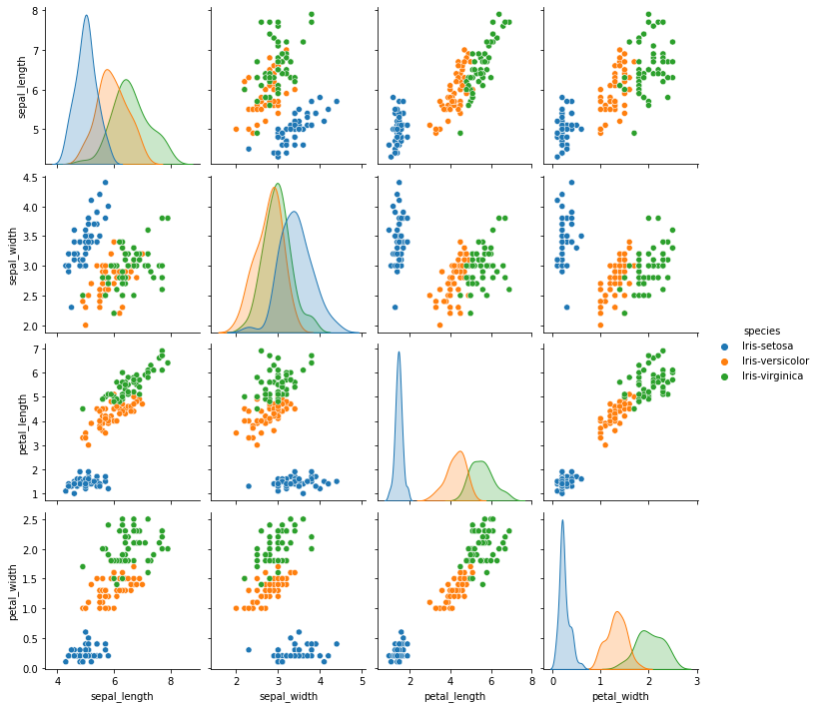
Multiclassification
Descriptive analysis

Slide 9
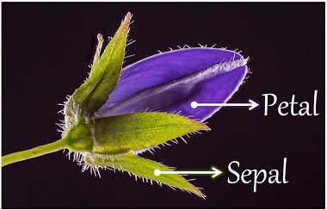
Multiclassification
Descriptive analysis
The size and width of the petals and sepals, vary depending on the species
We can get a sense of the project and set up a classification strategy through a pair-plot that shows how each attribute is related.

Slide 10
Multiclassification
One-hot encoding
How to predict classes with more than 2 classes?
For this, a one-hot encoding scheme is required.
from sklearn.preprocessing import LabelEncoder

Slide 11
Multiclassification
One-hot encoding
What is one-hot encoding?
ID | species
1 | Iris-setosa
2 | Iris-versicolor
3 | Iris-setosa
4 | Iris-virginica
5 | Iris-virginica
ID | setosa | versicolor | virginica
1 | 1 | 0 | 0
2 | 0 | 1 | 0
3 | 1 | 0 | 0
4 | 0 | 0 | 1
5 | 0 | 0 | 1
one-hot encoding

Slide 12
Multiclassification
One-hot encoding
① numeric encoding
ID | species
1 | Iris-setosa
2 | Iris-versicolor
3 | Iris-setosa
4 | Iris-virginica
5 | Iris-virginica
ID | species
1 | 0
2 | 1
3 | 0
4 | 2
5 | 2
numeric encoding
LabelEncoder( )
from sklearn.preprocessing import LabelEncoder

Slide 13
Multiclassification
One-hot encoding
② one-hot encoding
ID | species
1 | 0
2 | 1
3 | 0
4 | 2
5 | 2
ID | setosa | versicolor | virginica
1 | 1 | 0 | 0
2 | 0 | 1 | 0
3 | 1 | 0 | 0
4 | 0 | 0 | 1
5 | 0 | 0 | 1
one-hot encoding
to_categorical( )
from tensorflow.keras.utils import to_categorical

Slide 14
Multiclassification
One-hot encoding
How to conduct one-hot encoding?
https://colab.research.google.com/github/JunetaeKim/DeepLearningClass/blob/main/Week10/IrisOneHot.ipynb

Slide 15
Multiclassification
How to define a multiclassification model?
Comparison between binary and multiclassification model structures
Binary classification model structure
Even if there are two classes, the target layer can be set to one dimension.
1 vs 0
Input layer
Hidden layers
Output layer

Slide 16
Multiclassification
How to define a multiclassification model?
Comparison between binary and multiclassification model structures
Binary classification model structure
ID | survival
1 | 0
2 | 1
3 | 0
4 | 1
5 | 1
1 vs 0
Input layer
Hidden layers
Output layer

Slide 17
Multiclassification
How to define a multiclassification model?
Comparison between binary and multiclassification model structures
multiclassification model structure
In the case of a multi classification model, the target layer requires as many dimensions as the number of classes.
Input layer
Hidden layers
Output layer

Slide 18
Multiclassification
How to define a multiclassification model?
Comparison between binary and multiclassification model structures
multiclassification model structure
1
ID | setosa | versicolor | virginica
1 | 1 | 0 | 0
2 | 0 | 1 | 0
3 | 1 | 0 | 0
4 | 0 | 0 | 1
5 | 0 | 0 | 1
setosa
0
versicolor
0
virginica
Input layer
Hidden layers
Output layer

Slide 19
Multiclassification
How to define a multiclassification model?
Comparison between binary and multiclassification model structures
multiclassification model structure
0
ID | setosa | versicolor | virginica
1 | 1 | 0 | 0
2 | 0 | 1 | 0
3 | 1 | 0 | 0
4 | 0 | 0 | 1
5 | 0 | 0 | 1
setosa
1
versicolor
0
virginica
Input layer
Hidden layers
Output layer

Slide 20
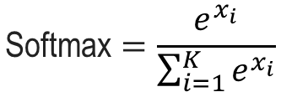
Multiclassification
How to define a multiclassification model?
Softmax function
The softmax function converts a vector of K real numbers into a probability distribution of K possible outcomes.
$$\text{Softmax}=\frac{e^{x_{i}}}{\sum_{i=1}^{K}{e^{x_{i}}}}$$

Slide 21
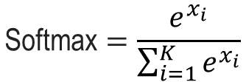
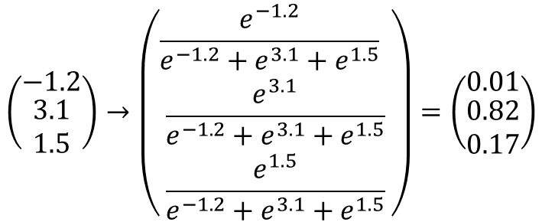
Multiclassification
How to define a multiclassification model?
Softmax function
$$\text{Softmax}=\frac{e^{x_{i}}}{\sum_{i=1}^{K}{e^{x_{i}}}}$$
$$\left(\begin{matrix}−1.2 \\ \begin{aligned}3.1 \\ 1.5\end{aligned}\end{matrix}\right)→\left(\begin{matrix}\frac{e^{−1.2}}{e^{−1.2}+e^{3.1}+e^{1.5}} \\ \begin{aligned}\frac{e^{3.1}}{e^{−1.2}+e^{3.1}+e^{1.5}} \\ \frac{e^{1.5}}{e^{−1.2}+e^{3.1}+e^{1.5}}\end{aligned}\end{matrix}\right)=\left(\begin{matrix}0.01 \\ \begin{aligned}0.82 \\ 0.17\end{aligned}\end{matrix}\right)$$

Slide 22

Multiclassification
How to define a multiclassification model?
Softmax function
The sum of values ​​converted to softmax must be 1
$$\left(\begin{matrix}−1.2 \\ \begin{aligned}3.1 \\ 1.5\end{aligned}\end{matrix}\right)→\left(\begin{matrix}\frac{e^{−1.2}}{e^{−1.2}+e^{3.1}+e^{1.5}} \\ \begin{aligned}\frac{e^{3.1}}{e^{−1.2}+e^{3.1}+e^{1.5}} \\ \frac{e^{1.5}}{e^{−1.2}+e^{3.1}+e^{1.5}}\end{aligned}\end{matrix}\right)=\left(\begin{matrix}0.01 \\ \begin{aligned}0.82 \\ 0.17\end{aligned}\end{matrix}\right)$$
$$0.01+0.82+0.17=1$$

Slide 23
Multiclassification
How to define a multiclassification model?
multiclassification model structure with tensorflow 2.x
Input
Hidden1
Hidden2
Output
relu
tanh
softmax
(None,4)
(None,5)
(None,3)
(None,3)

Slide 24
Multiclassification
How to define a multiclassification model?
multiclassification model structure with tensorflow 2.x
https://colab.research.google.com/github/JunetaeKim/DeepLearningClass/blob/main/Week10/IrisMultiClassification.ipynb

Slide 25
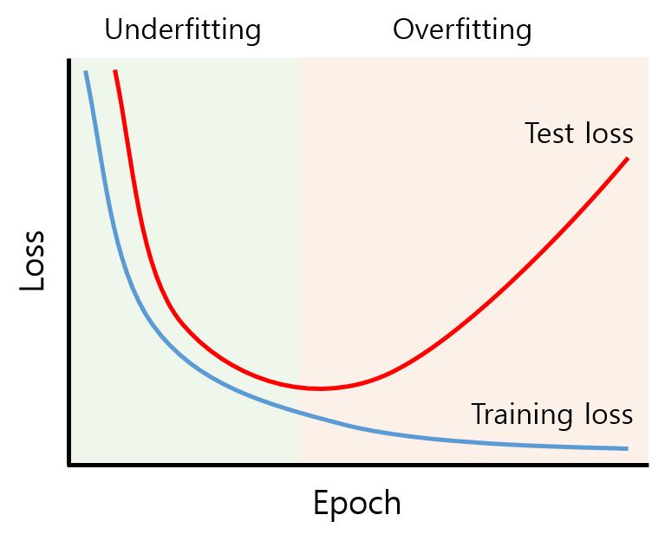
Understanding Overfitting
Overfitting
The production of an analysis that corresponds too closely or exactly to a particular set of data, and may therefore fail to fit to additional data or predict future observations reliably (wiki)
https://untitledtblog.tistory.com/158

Slide 26
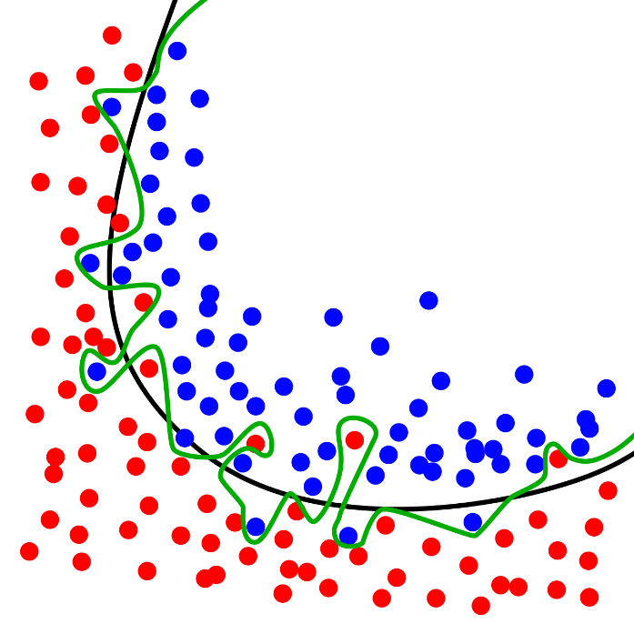
Understanding Overfitting
Overfitting
The production of an analysis that corresponds too closely or exactly to a particular set of data, and may therefore fail to fit to additional data or predict future observations reliably (wiki)
Black: excellent fit
Green: overfit
Yellow: underfit
https://en.wikipedia.org/wiki/Overfitting#/media/File:Overfitting.svg

Slide 27
Understanding Overfitting
Data split
How to control learning to produce optimal results?
Optimal results
Training should be stopped at a point where the test results no longer improve with training.

Slide 28
Understanding Overfitting
Data split
How to control learning to produce optimal results?
Optimal results
We need to split the data into a training and validation set

Slide 29
Understanding Overfitting
Data split
How to split the data into a training and validation set using python?
from sklearn.model_selection import train_test_split
X_train, X_test, Y_train, Y_test = train_test_split(X,Y, test_size=0.2, random_state=0)
Dataset
Training
Validation
For training weights
For stop training

Slide 30
Understanding Overfitting
Overfitting
Understanding overfitting based on implementation
https://colab.research.google.com/github/JunetaeKim/DeepLearningClass/blob/main/Week10/IntroOverfit.ipynb

Slide 31
Understanding Overfitting
Data split
Training set, validation set, and test set.
Dataset1
Training
Validation
For training weights
For stop training
Dataset2
Optimal model
Testing for generalizability

Slide 32
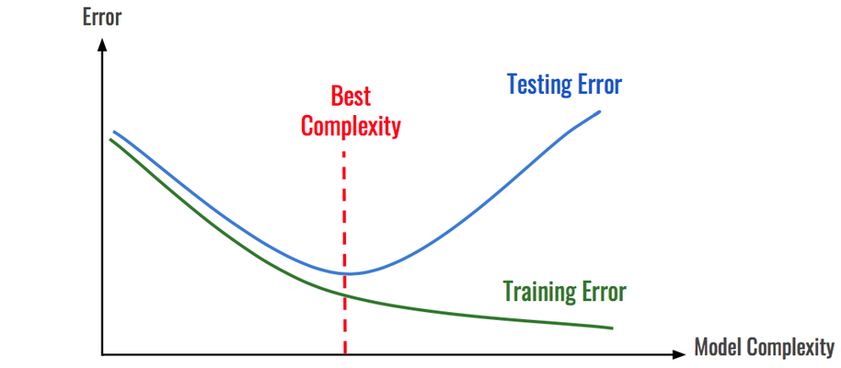
Understanding Overfitting
When does the overfitting problem occur?
When the model structure is complex.
https://image.jimcdn.com/app/cms/image/transf/dimension=1920x400:format=png/path/s8ff3310143614e07/image/i21af0dd4f2772075/version/1550368786/image.png

Slide 33
Understanding Overfitting
When does the overfitting problem occur?
Perform overfitting experiments depending on hidden layer complexity
https://colab.research.google.com/github/JunetaeKim/DeepLearningClass/blob/main/Week10/ExpOverfitComplex.ipynb

Slide 34
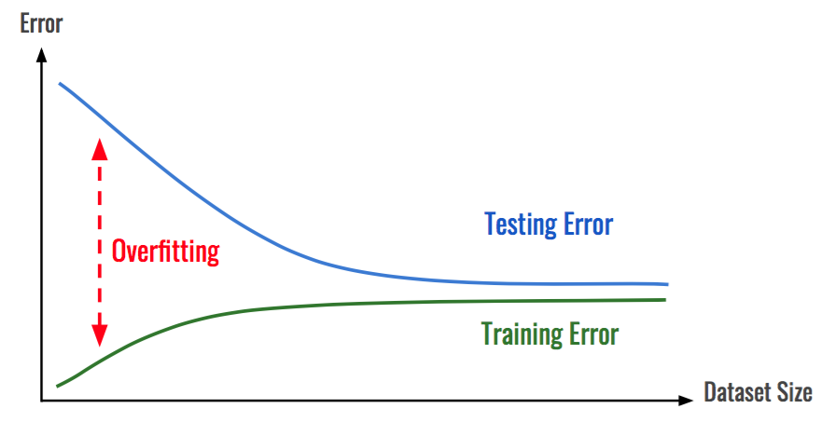
Understanding Overfitting
When does the overfitting problem occur?
When data is insufficient
https://blog.kakaocdn.net/dn/bsNLy6/btq4bBRDhgu/pt8cbOq1e9pkalI695QnTK/img.png

Slide 35
Understanding Overfitting
When does the overfitting problem occur?
When data is insufficient
https://colab.research.google.com/github/JunetaeKim/DeepLearningClass/blob/main/Week10/ExpOverfitTrSize.ipynb

Slide 36
K-fold cross validation
Background
One of the most difficult problems when working with deep learning or machine learning is that even if an algorithm has been sufficiently tested, if there is not enough data, the results are difficult to generalize.
The method developed to address the issue is k-fold cross-validation.

Slide 37
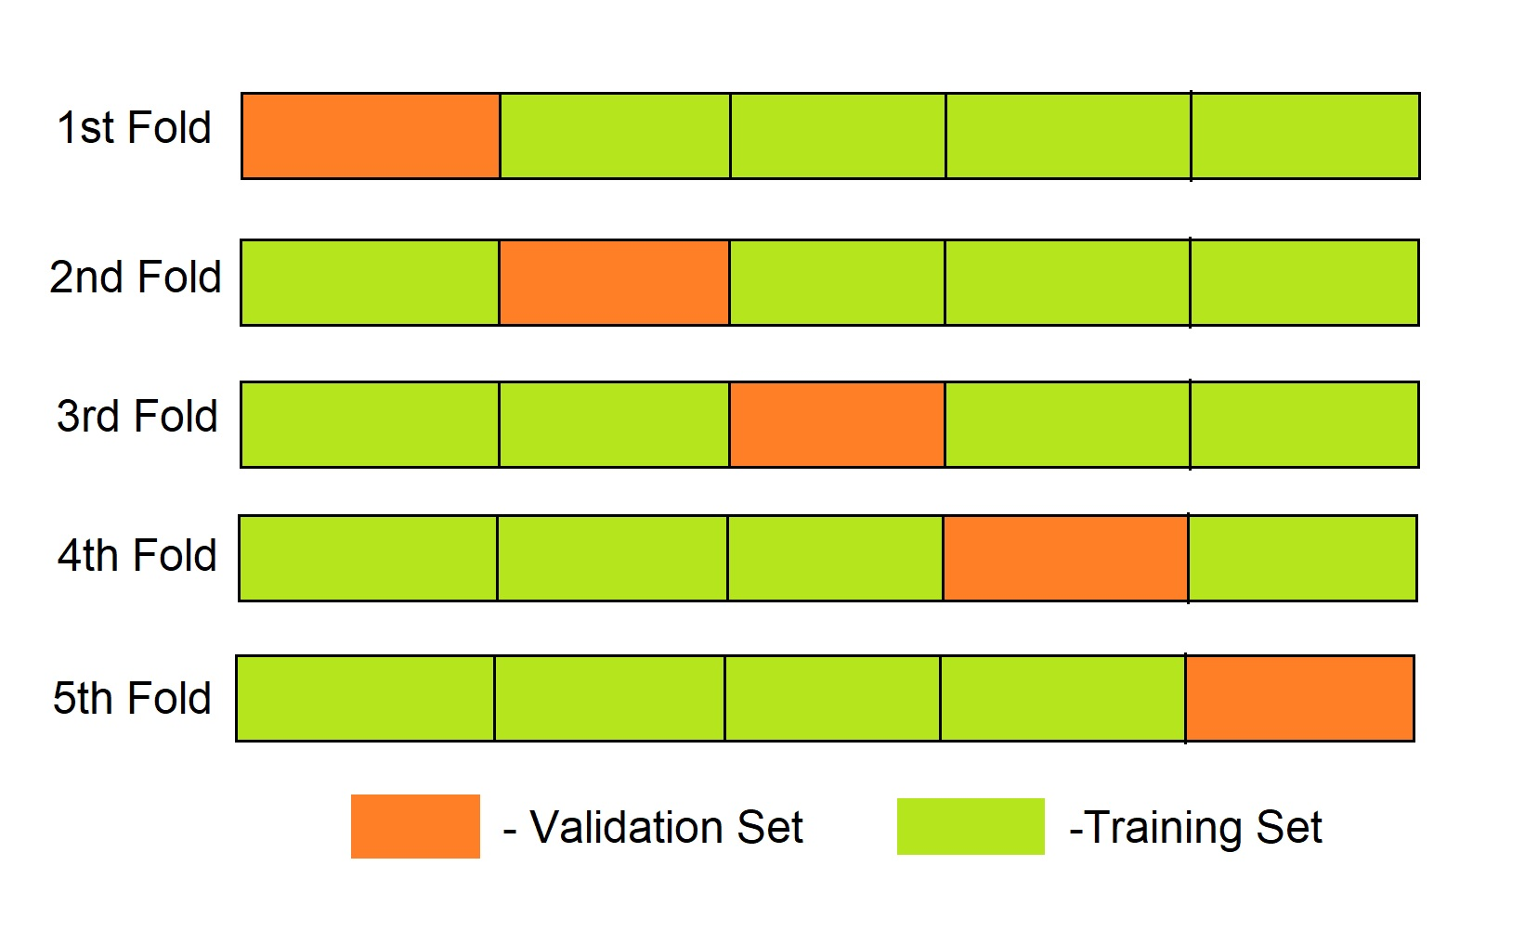
K-fold cross validation
What is K-fold cross validation
A method of dividing the dataset into several parts and using each one as a test set and combining the rest to use as a training set.
This allows 100% of the data to be used as the test set.
https://www.askpython.com/python/examples/k-fold-cross-validation

Slide 38
K-fold cross validation
How to perform k-fold cross-validation
from sklearn.model_selection import StratifiedKFold
https://colab.research.google.com/github/JunetaeKim/DeepLearningClass/blob/main/Week10/KfoldValidation.ipynb

Slide 39
K-fold cross validation
Exercise goal
① Iris classification model development
Input
Hidden1
Hidden2
Output
relu
tanh
softmax
(None,4)
(None,5)
(None,3)
(None,3)

Slide 40
K-fold cross validation
Exercise goal
② Conducting 5-fold cross validation

Slide 41
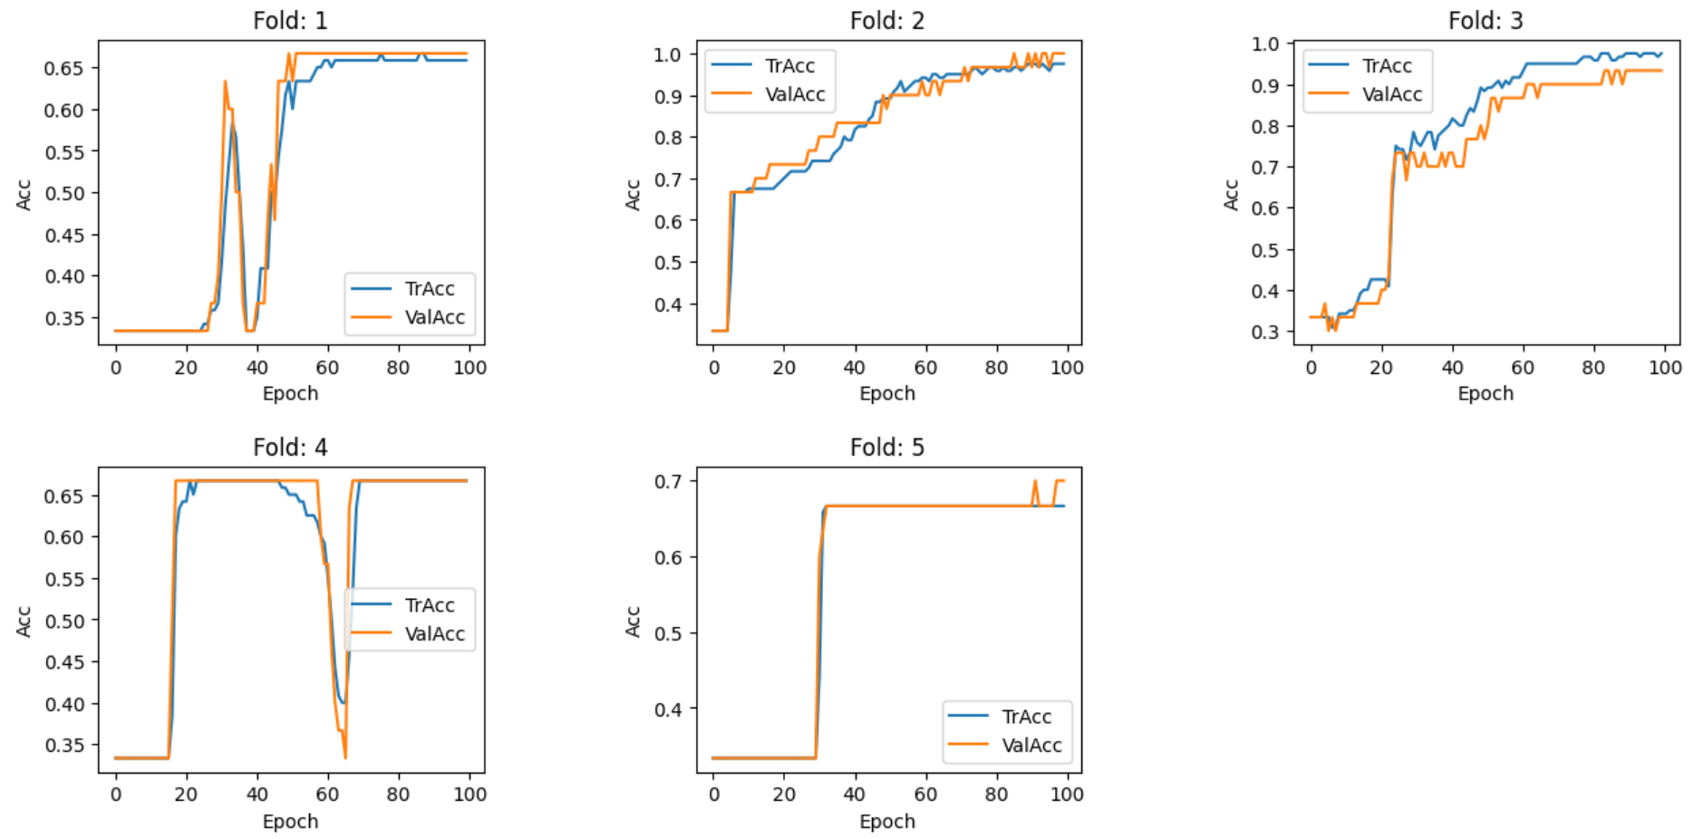
K-fold cross validation
Exercise goal
③ Visualization of both training and validation accuracies over epochs per fold.

Slide 42
K-fold cross validation
Exercise
① Iris classification model development
② Conducting 5-fold cross validation
③ Visualization of both training and validation accuracies over epochs per fold
For students
https://colab.research.google.com/github/JunetaeKim/DeepLearningClass/blob/main/Week10/Exercise.ipynb

